Slide 1
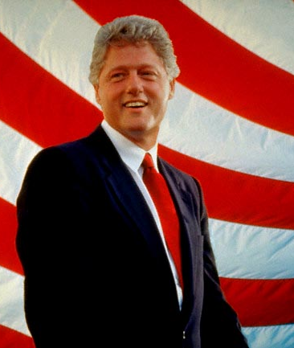
The Presidency of William Jefferson Clinton
1993-2001

Slide 2
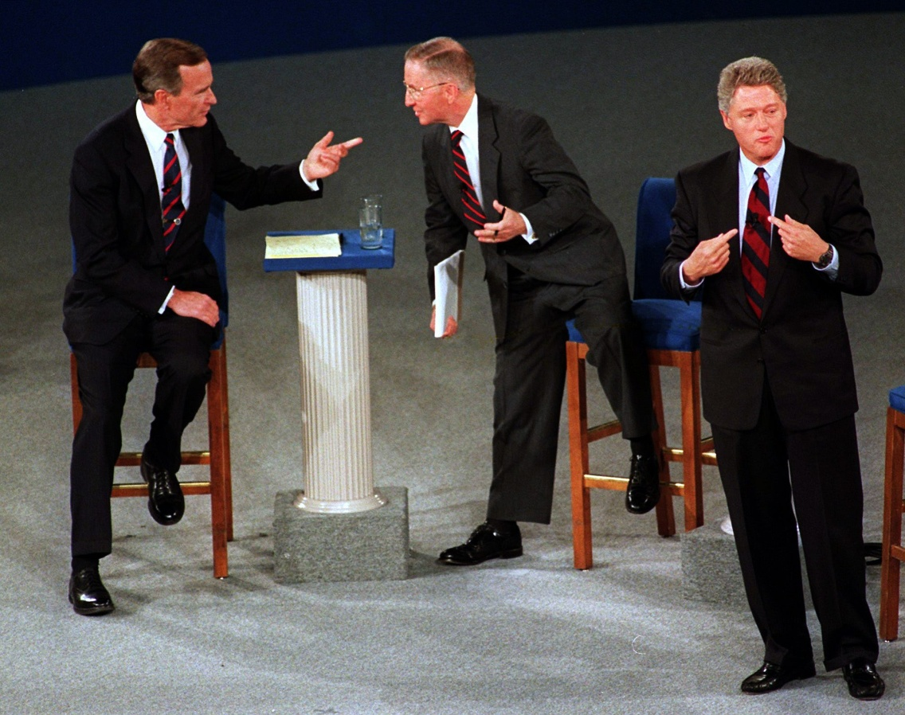
Road to the Whitehouse
Bill Clinton defeated George H. Bush, limited Bush to one term as President
Many were surprised to see Clinton win the election as his campaign was plagued by scandals involving women.
The election included the added excitement of a recognized third-party candidate, Ross Perot

Slide 3
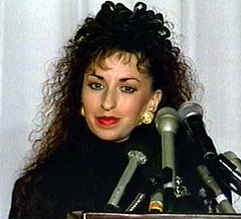
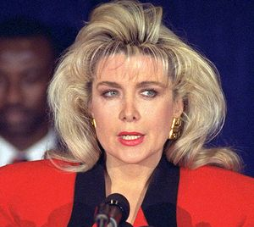
Road to the Whitehouse
During the campaign, Clinton was accused of sexual harassment by Paula Jones
Clinton was also accused of having an inappropriate relationship with Gennifer Flowers
Despite the scandals involving these women, Clinton was elected.

Slide 4
Ask Yourself…
The personal lives of many famous people are prone to public scrutiny. Do you think it is fair that Bill Clinton was forced to address questions about his personal relationships when running for office?
Would these scandals have impacted your decision to vote for Bill Clinton? Why?

Slide 5
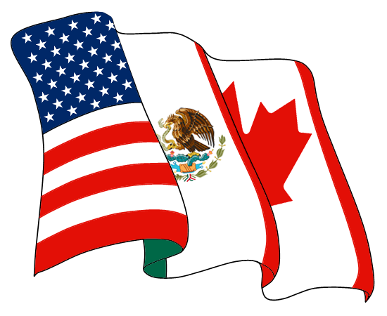
NAFTA
On January 1, 1994 the North American Free Trade Agreement took effect.
Under the NAFTA, Many tariffs were eliminated between the U.S., Canada, and Mexico
NAFTA was meant to stimulate the economy by encouraging increased free trade

Slide 6
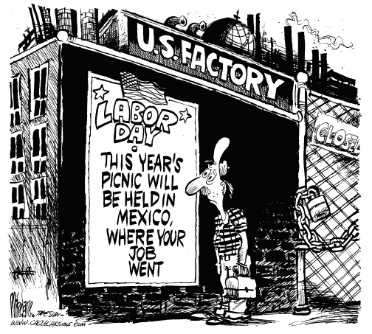
NAFTA
NAFTA has had both positive and negative effects
Many point to the poor working conditions in factories on the U.S./Mexico border and the loss of jobs in the U.S. as consequences
Others point to the jobs created as a result of increased free trade and increased agricultural production in the U.S. as benefits

Slide 7
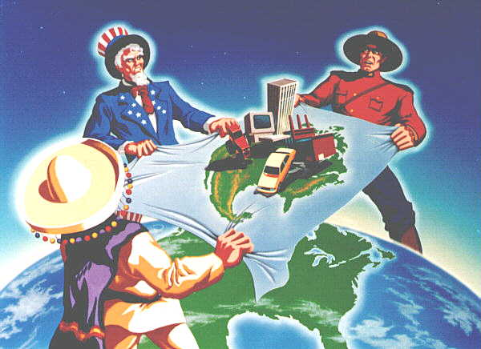
Ask Yourself…
Did President Clinton make the right choice in allowing the U.S. to take part in NAFTA?
Should the United States continue to participate in NAFTA now? Why or why not?

Slide 8
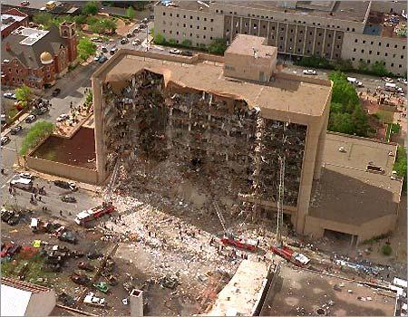
American Terrorism
In 1995 Clinton was forced to confront terrorism.
A Ryder truck filled with explosives was used to blow up the Federal Building in Oklahoma City
Timothy McVeigh, an army veteran, was convicted for planning the bombing

Slide 9
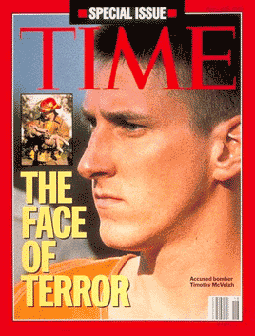
American Terrorism
In response to the bombing, Congress passed the Anti-Terrorism Act in 1996
The Act was in many way similar to the Patriot Act that was signed following the 9/11 attacks
Timothy McVeigh, was sentenced to death and was executed in 2001

Slide 10

Ask Yourself…
Did the Congress and President Clinton make the right decision by signing the Anti-Terrorism act into law?
If you were President during the Oklahoma City bombing, how would you have reacted?

Slide 11
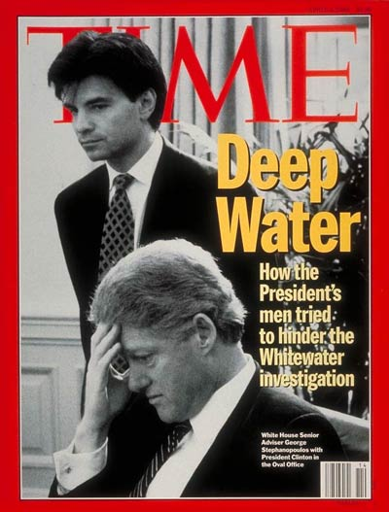
Whitewater
This scandal was named for a failed 1970s Arkansas real estate venture by the Whitewater Development Corp., in which Governor (later President) Bill Clinton and his wife were partners.
Accusations of impropriety against the Clintons surfaced, regarding improper campaign contributions, political and financial favors, and tax benefits
The Clintons were also accused of hiding files, which they claim to have lost

Slide 12
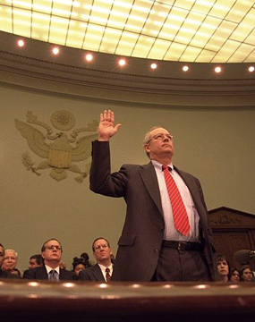
Starr Investigation
In 1996, other participants in the Whitewater investment were found guilty of fraud.
Whitewater was investigated by a special prosecutor beginning in 1994 and by congressional committees in 1995–96.
Special prosecutor Kenneth Starr’s investigation included testimony from Mrs. Clinton (which was the first time a first lady was subpoenaed by a grand jury) and videotaped testimony from the president.

Slide 13
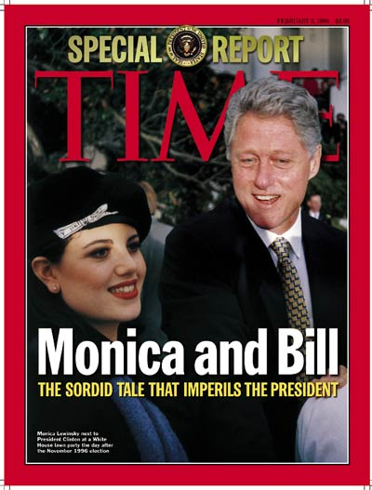
More Scandal in the Whitehouse
During the grand jury investigation, Bill Clinton lied under oath regarding his personal relationship with Whitehouse intern Monica Lewinsky
Clinton continued to deny the relationship until evidence of the relationship was brought to light.
Many demanded that the President be punished for committing perjury.

Slide 14
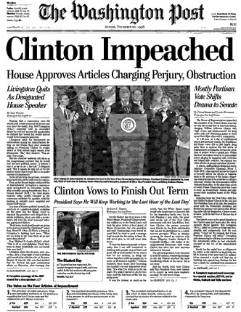
Impeachment
On December 18, 1998, the U.S. Congress voted to impeach the President.
The United States Senate did not vote to impeach the President and he remained in office.

Slide 15
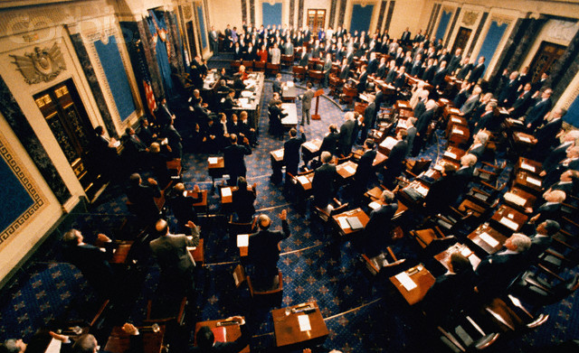
Ask Yourself…
Was President Clinton wrong for lying about his relationship with Monica Lewinsky?
How did Clinton’s actions impact the image of the Presidency?
Do you think the U.S. Senate should have voted to impeach the President?

Slide 16
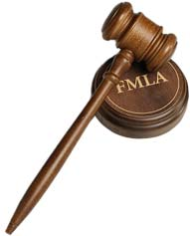
Successes of the Clinton Presidency
The Family Medical Leave Act (FMLA) was passed by the Clinton administration
Interest rates were drastically reduced on loans, allowing for more people to affordably borrow money for the purchase of homes and cars.
Welfare programs were reformed so welfare recipients would not receive assistance for more than two years and required people to work to receive benefits.

Slide 17
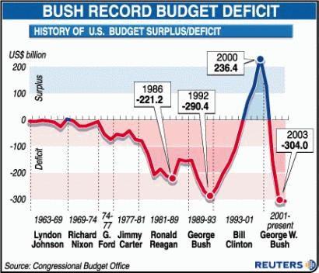
Successes of the Clinton Presidency
By raising income taxes and taxes on fuel, Clinton was able to overcome the national debt and create a budget surplus

Slide 18
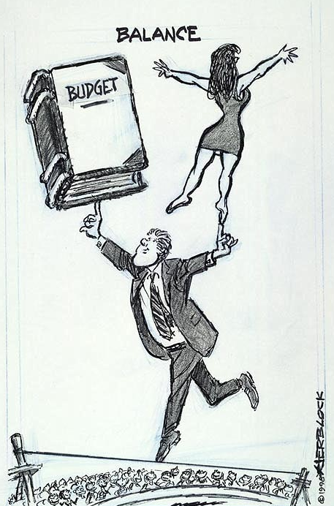
Ask Yourself…
Considering all of the information you have just learned, do you think Bill Clinton was a good President or a bad one? Why?

